Slide 1
SHAC Presentation Teaching and Learning

Slide 2
AGENDA
Review Middle School Health Curriculum
Sensitive Content Only
Proposed Timeline for Future Meetings

Slide 3
SHAC ROLE FOR REVIEWING SENSITIVE CONTENT
The role of SHAC, as per HB 1525, is to review and advise on the suitability of any proposed curriculum content in the following areas before making final recommendations to the Board of Trustees:
The Prevention of Child Abuse and/or Family Violence
The Prevention of Dating Violence
The Prevention of Sex Trafficking
Human Sexuality
Reproductive Health
Tex. Educ. Code § 28.004(c)(3), (c)(8)

Slide 4
PREVIOUSLY REVIEWED MIDDLE SCHOOL HEALTH
Teacher-made instructional materials, human sexuality content
Notes:
Reviewed, First Public Meeting, February 23, 2022; Second Public Meeting May 4, 2022 – Reviewed this curriculum for those in attendance for both public meetings.

Slide 5
10/19/2020
Vocabulary
Endocrine System - The glands and organs that make hormones and release them directly into the blood so they can travel to tissues and organs all over the body. The hormones released by the endocrine system control many important functions in the body, including growth and development, metabolism, and reproduction.

Slide 6
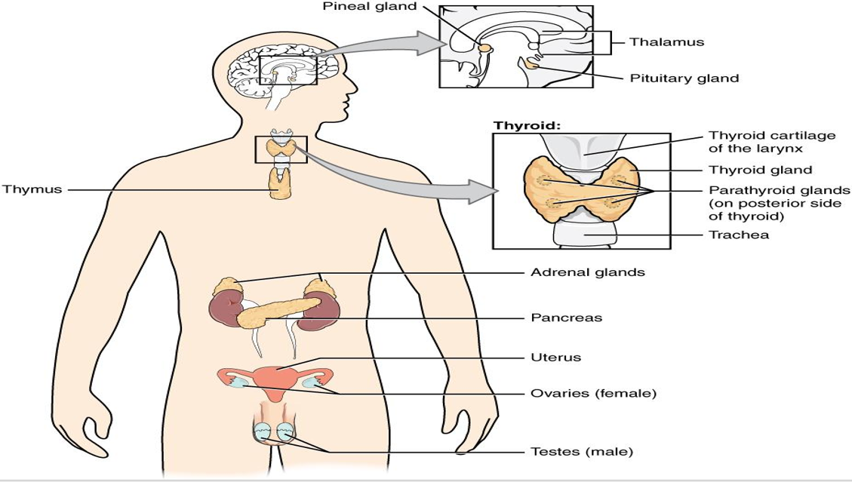

Slide 7
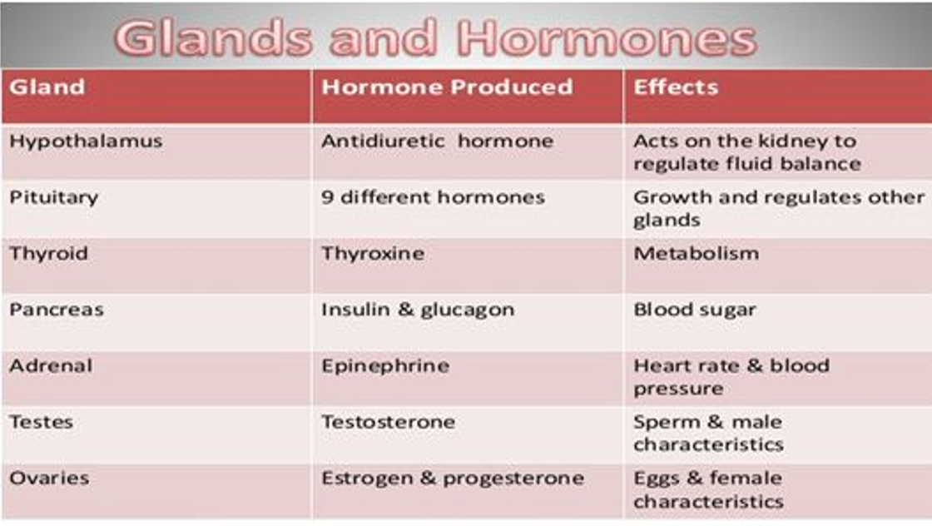

Slide 8
How does the Endocrine System influence your body?
Feedback from small groups.

Slide 9
Links to videos used in class as part of lessons
All About Getting Your Period 2:26
Taking Care of Your Body During Puberty 2:45
Consent Explained. What Is It? 1:46
The Endocrine System 1:43
The Endocrine System Song 2:29
Notes:
SHAC review – SHAC requested all references to amaze.org be removed before using the first three videos and recommending approval to the Board of Trustees.

Slide 10
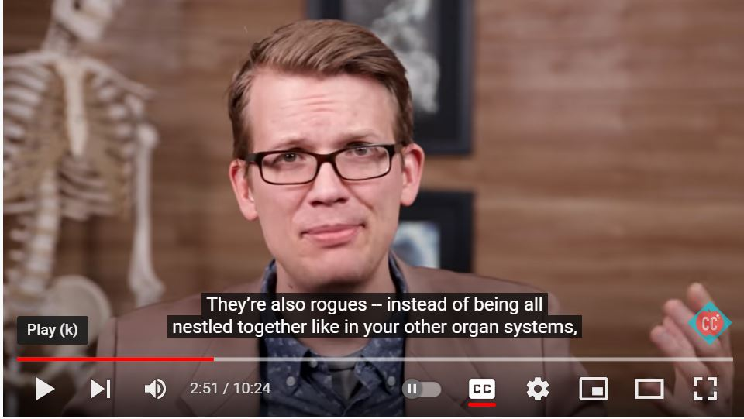
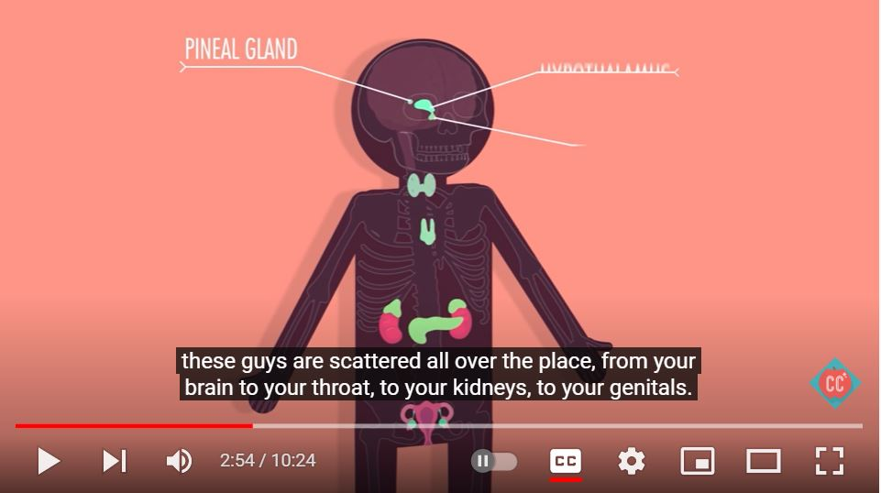
Endocrine System, Part 1 - Glands & Hormones 10:24
(Sensitive content is to 1:07 and in the following five slides)

Slide 11
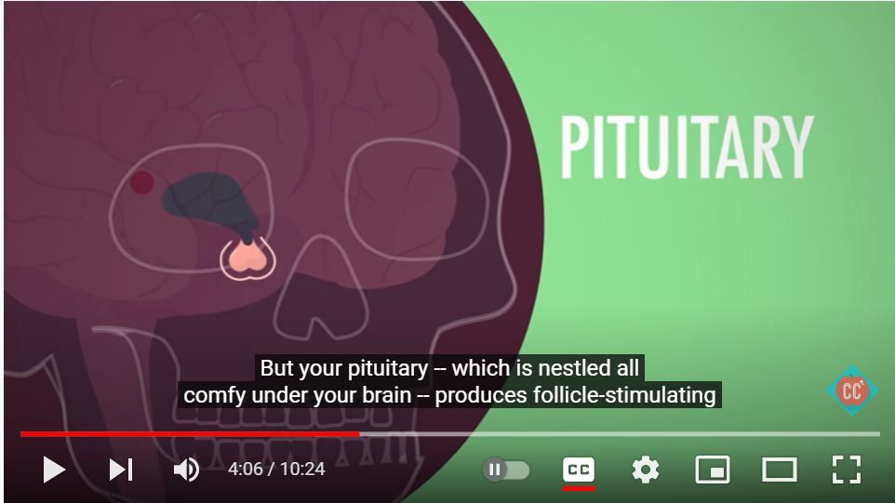
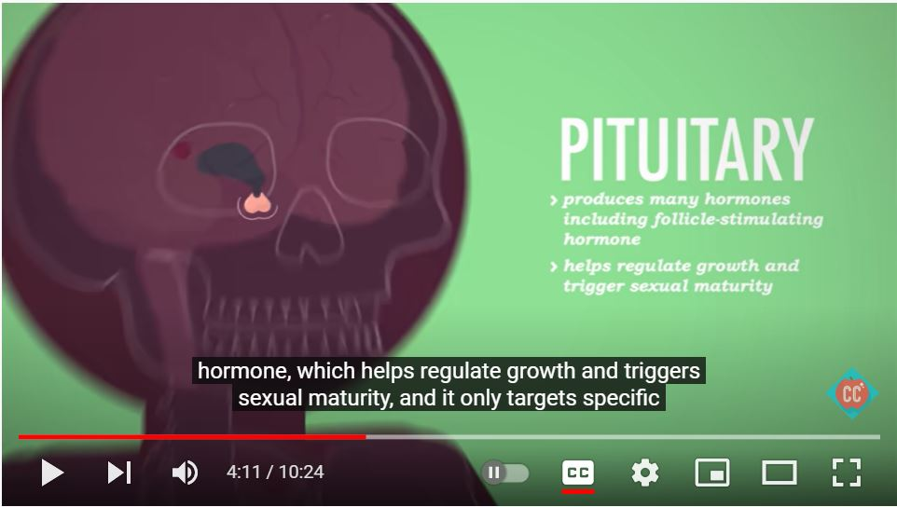
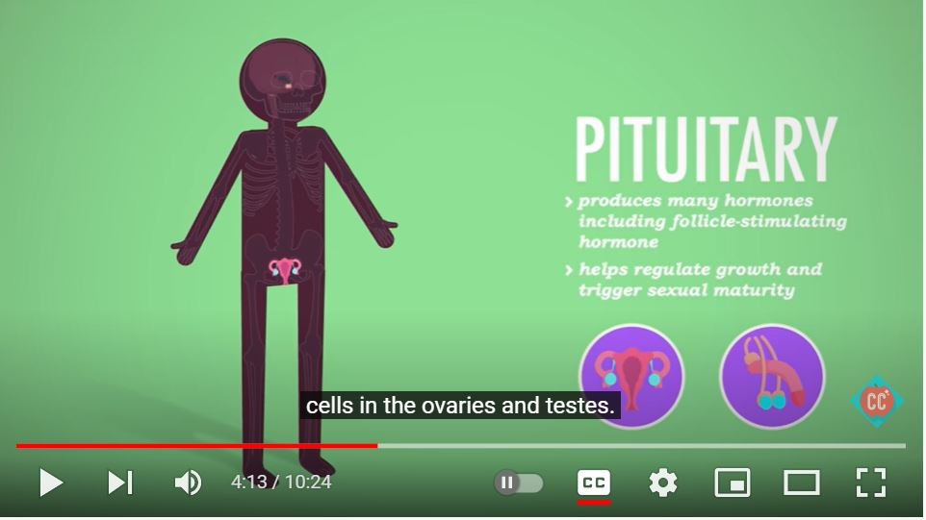

Slide 12
PROPOSED TIMELINE
May 4, 2022 SHAC Meeting
Review 8th Grade Health Curriculum (Sensitive Content Only)
May 17, 2022 Board Meeting
Recommend Approval of the 8th Grade Health Curriculum
September, 2022
September 7, 2022 - SHAC Meeting (Public Meeting #1) - HCCAC and Raffa Present Programs
September 14, 2022 – Public Meeting #2 – HCCAC and Raffa Present Programs
October, 2022
October 5, 2022 – SHAC Meeting (Public Meeting #1) - WIN and Youth180 Present Programs
October 12, 2022 – Public Meeting #2 – WIN and Youth180 Present Programs
October 18, 2022 – SHAC Recommendations for Community Programs to the GISD School Board
Notes:
After SHAC discussion, Board Meeting approval slide was changed from the June Board meeting to the May Board meeting. SHAC agreed that either one was acceptable. The September and October timelines are proposed, but flexible depending on the decisions of the new district leadership and new SHAC for 2022-23.

Slide 13
CONSENSUS ON RECOMMENDATION TO THE BOARD
The role of SHAC, as per HB 1525, is to review and advise on the suitability of any proposed curriculum content in the following areas before making final recommendations to the Board of Trustees:
The Prevention of Child Abuse and/or Family Violence
The Prevention of Dating Violence
The Prevention of Sex Trafficking
Human Sexuality
Reproductive Health
Tex. Educ. Code § 28.004(c)(3), (c)(8)

Slide 14
QUESTIONS?

